Slide 1


Clinicians, Big Data and Digital Research
Dr. Richard Issitt
Dr. Ben Margetts ( @BenKMargetts)
November 2019

Slide 2
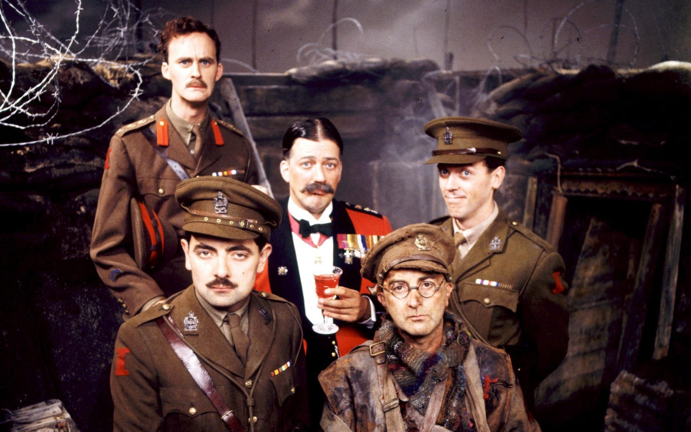
War stories from GOSH’s Digital Research Environment
Dr. Richard Issitt
Dr. Ben Margetts ( @BenKMargetts)
November 2019

Slide 3

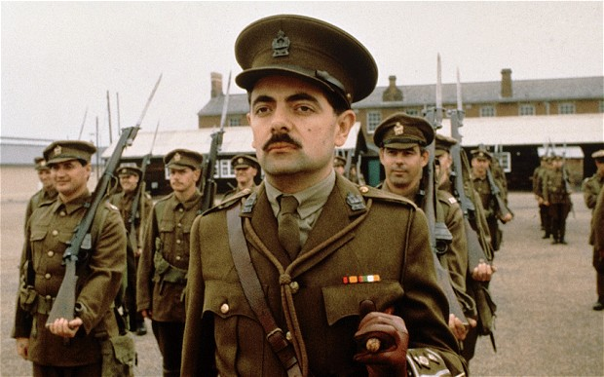
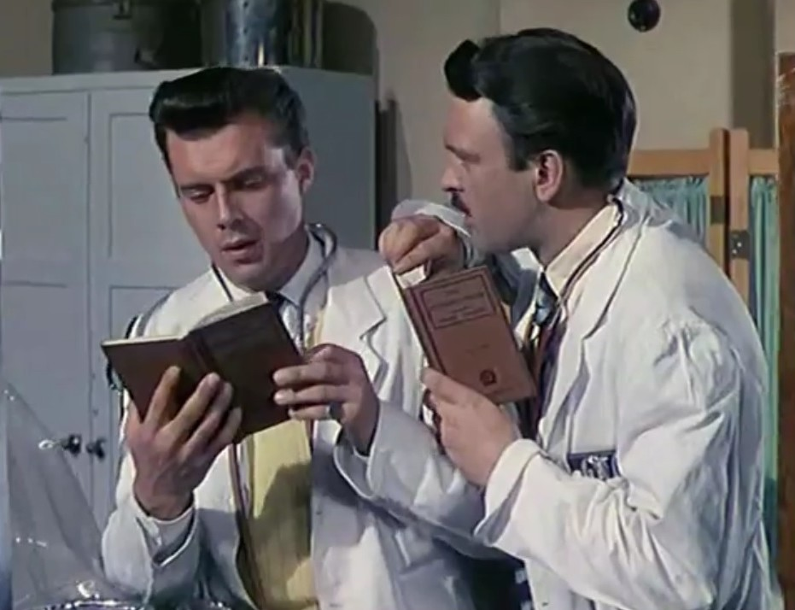
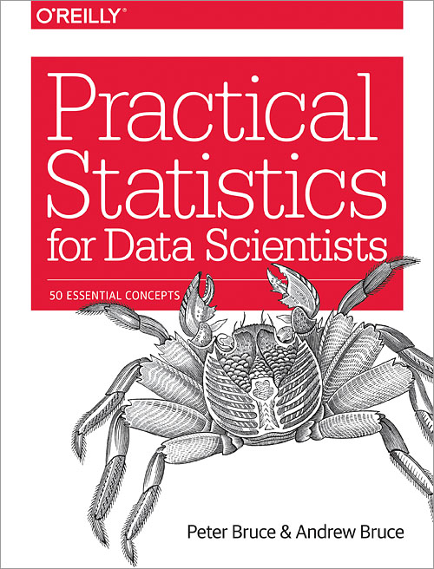

New Recruits: Day 1 of the Digital Research Environment
Ben - Entering no man’s land :
GOSH’s First Data Scientist
Richard - Going over the top:
Clinician taking the statistical p(lunge)

Slide 4

Excited to Start!
`

Slide 5
Digital Strategy 2017
Meanwhile…..

Slide 6
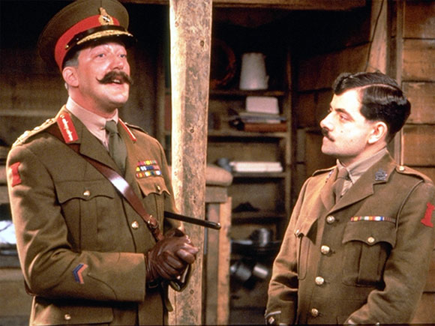
Digital Strategy 2017
It’s all part of the Grand Plan
AI in the hospital by Christmas!

Slide 7

it’s too quiet…
I don’t like it…
Sergeant…

Slide 8
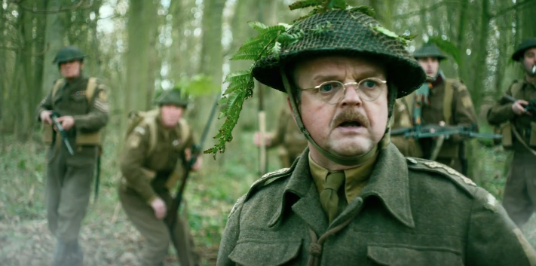


Slide 9
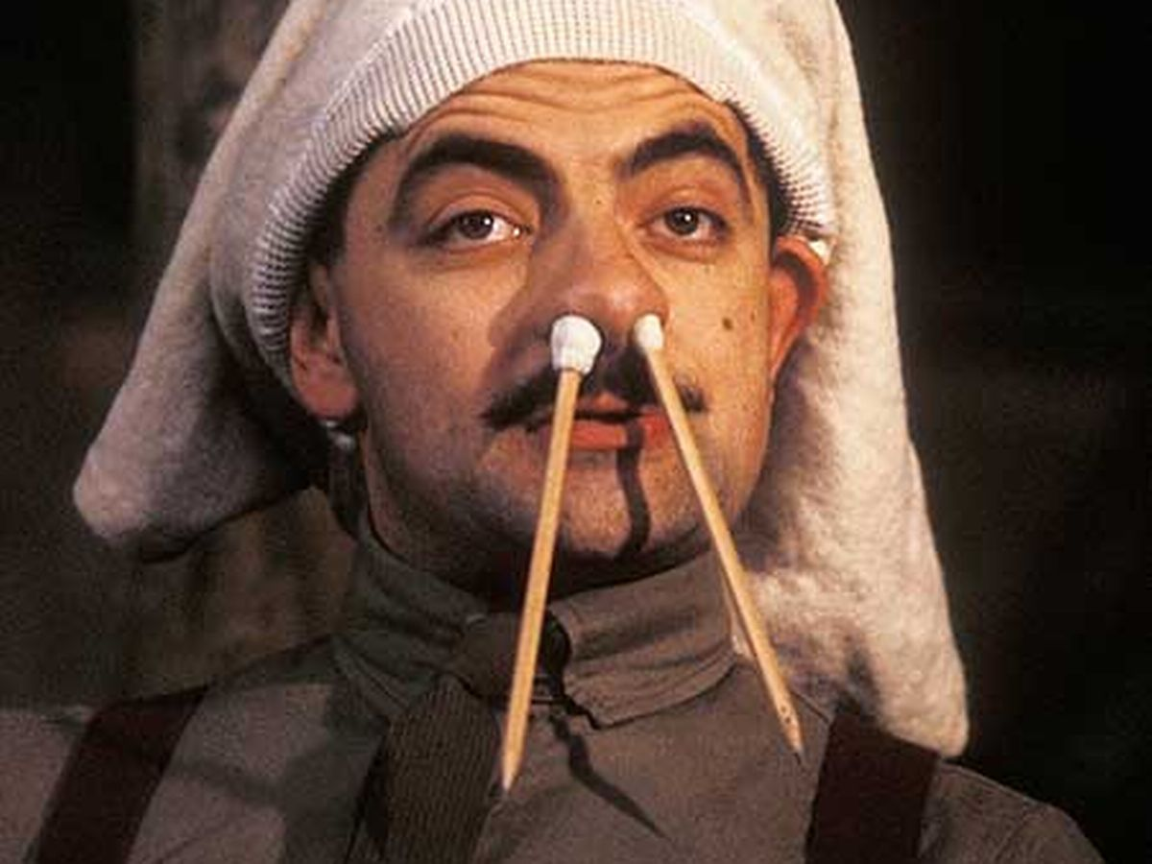
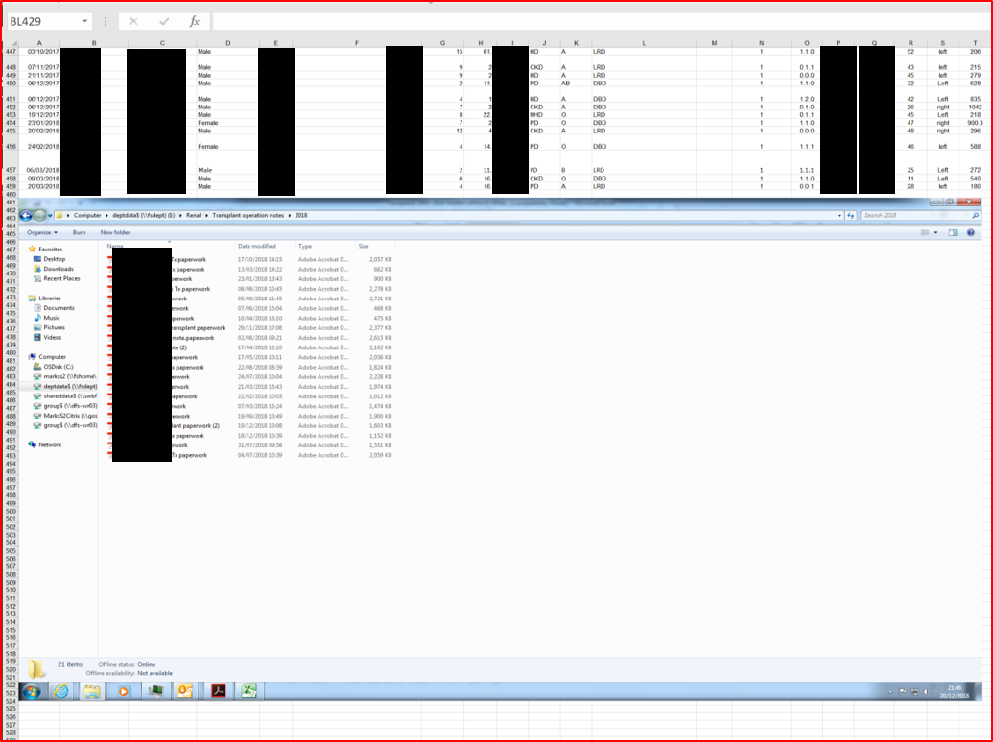
First Casualty of War
Clinical ‘database’
Screenshot embedded in spreadsheet of patient paperwork as data entry

Slide 10
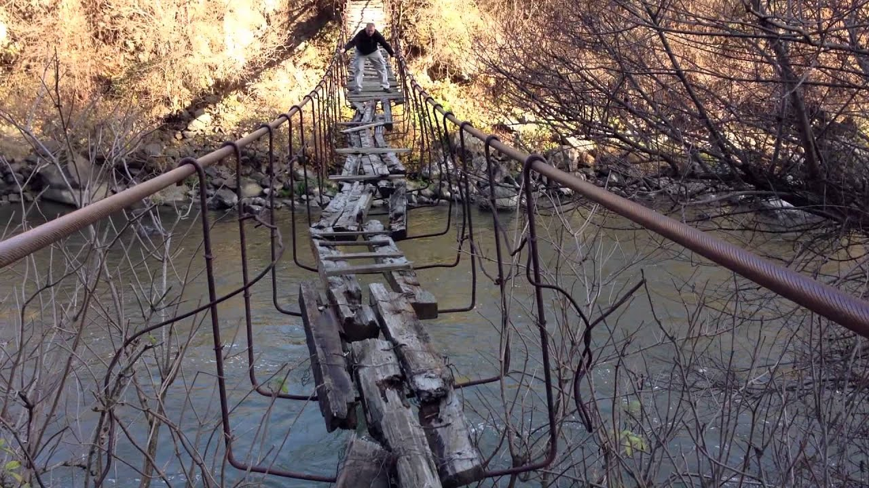

A Bridge Too Far
Data Scientists
Rest of Hospital

Slide 11



Building Bridges

Slide 12
Building Bridges
R Programming

Slide 13

Building Bridges
Exemplar Projects

Slide 14
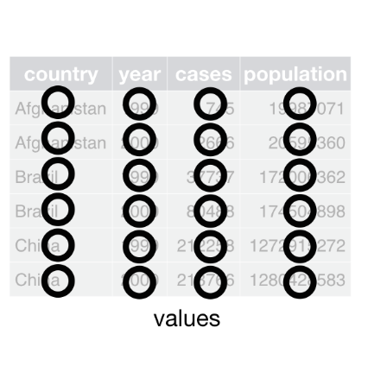
Building Bridges
Research Data Views

Slide 15

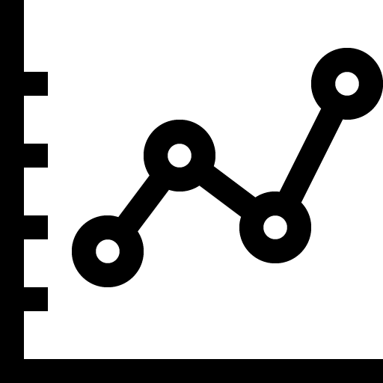
Building Bridges
Data Table Analytics

Slide 16

Building Bridges
Open Source Tools

Slide 17

Building Bridges
R Shiny

Slide 18

Building Bridges

Slide 19
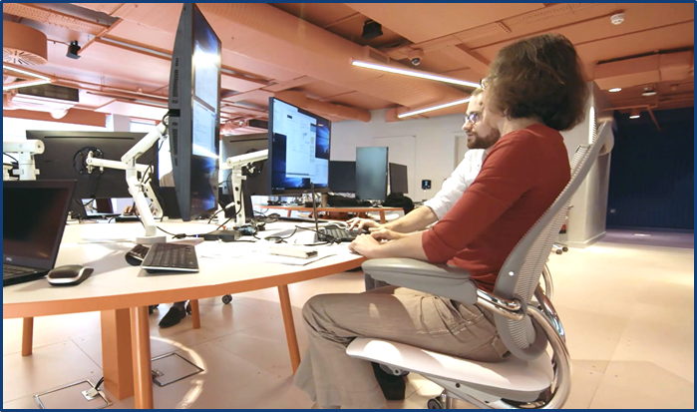
Building Bridges
DRE Open Sessions

Slide 20
Building Bridges
DRE Open Sessions

Slide 21
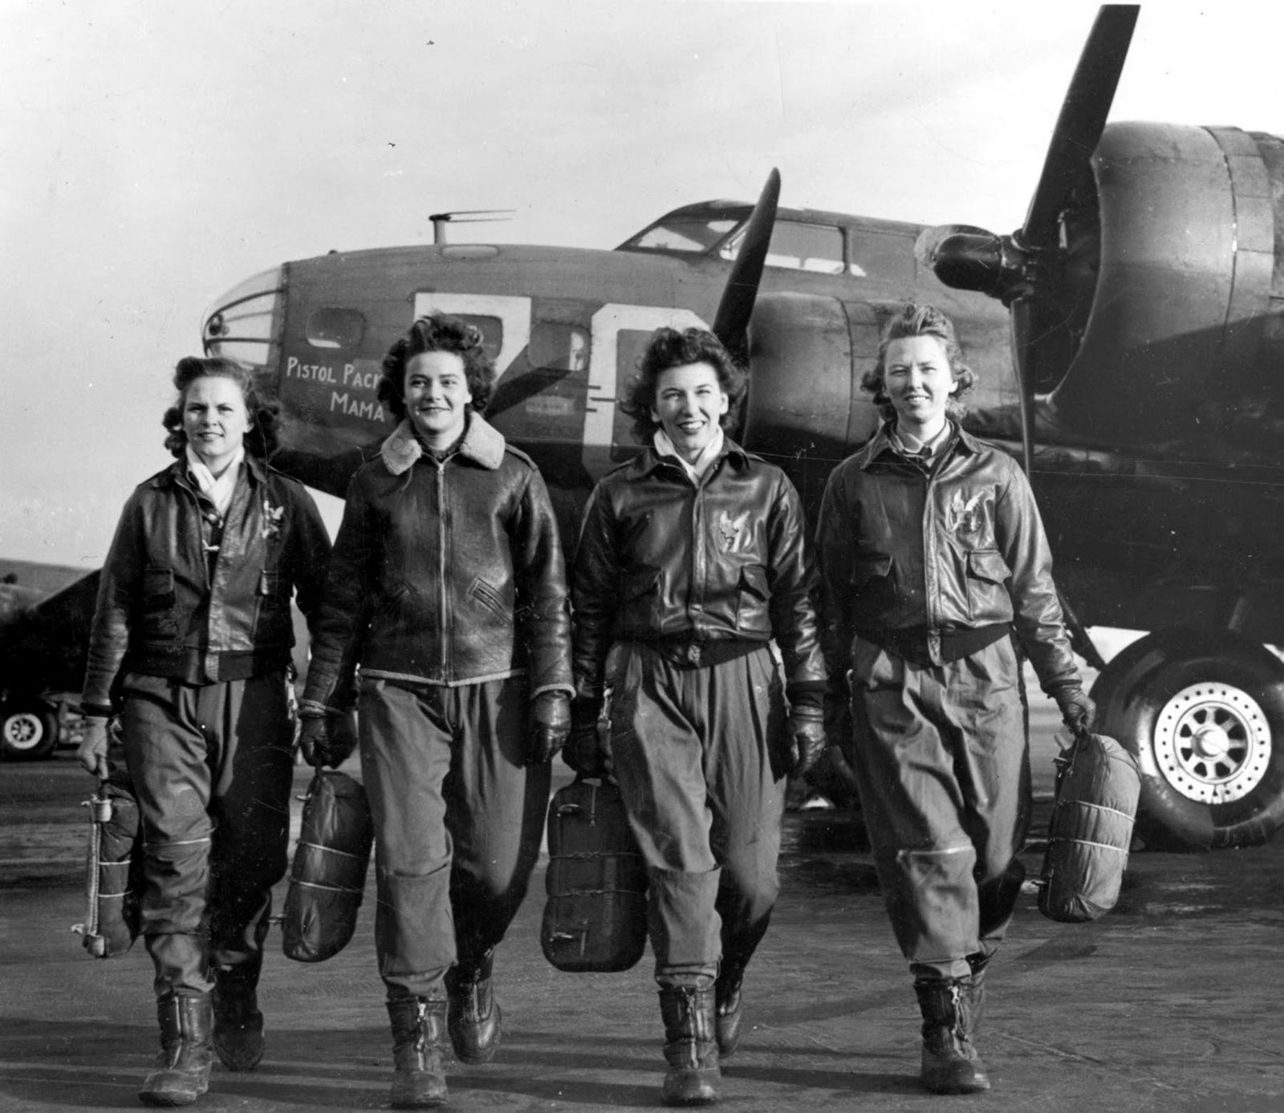



Home in time for Christmas (2019)

